Slide 1

GUESS THE WORD

Slide 2
AGE AGE AGE
Notes:
Middle Age

Slide 3

1/4
Notes:
Headquarter

Slide 4
TRAVEL CCCCCCC
Notes:
Travel overseas

Slide 5
Q Me
Notes:
Excuse Me

Slide 6
ME - IT
Notes:
Take it from me

Slide 7
TRY
STAND
2
Notes:
Try to understand

Slide 8
Doft.or
Notes:
One foot in the door

Slide 9
ET
Notes:
Blanket

Slide 10
GET IT GET IT GET IT GET IT
Notes:
Forget it

Slide 11
ROOD
Notes:
backdoor

Slide 12
BUSH
B
T
E
A
Notes:
Beat around the bush

Slide 13
MILL1ON
Notes:
One in a million

Slide 14
SHIP
Notes:
spaceship

Slide 15
H I L L
Notes:
downhill

Slide 16
ISSUES ISSUES ISSUES ISSUES ISSUES
ISSUES ISSUES ISSUES ISSUES ISSUES
Notes:
Tennis shoes

Slide 17
READ
Notes:
Read in between the lines

Slide 18
BLOOD WATER
Notes:
Blood is thicker than water

Slide 19
Vision Vision
Notes:
Double Vision

Slide 20
Frequency
Notes:
High Frequency

Slide 21
JOB
Notes:
Inside job

Slide 22
2. BLAME 3. BLAME 4. BLAME
Notes:
No one to blame

Slide 23
T T T T
YEARS
Notes:
Forty years

Slide 24
S T A N D
ME
Notes:
Stand by Me

Slide 25
ARREST
YOU’RE
Notes:
You’re under arrest

Slide 26
DO DO LIST
Notes:
To Do List

Slide 27
LEAST
Notes:
Last but not least

Slide 28
1
Notes:
Hole in 1

Slide 29


vi
Notes:
Family visit

Slide 30
tune tune tune tune
Notes:
fortune

Slide 31
0 2345678
stands
Notes:
No one understands

Slide 32
vice + vice
Notes:
advice

Slide 33
Time
Be
Notes:
Be on time

Slide 34
Y N N U S
Notes:
Sunny side up

Slide 35



Notes:
Not rocket science

Slide 36
scope
Notes:
microscope

Slide 37


=
Notes:
A picture is worth a thousand words

Slide 38
familyyyyyyyy
Notes:
Extended family

Slide 39
secret secret secret secret
Notes:
Top secret

Slide 40

lost lost lost lost
g
n
i
K
a
m
Notes:
Making up for lost time

Slide 41
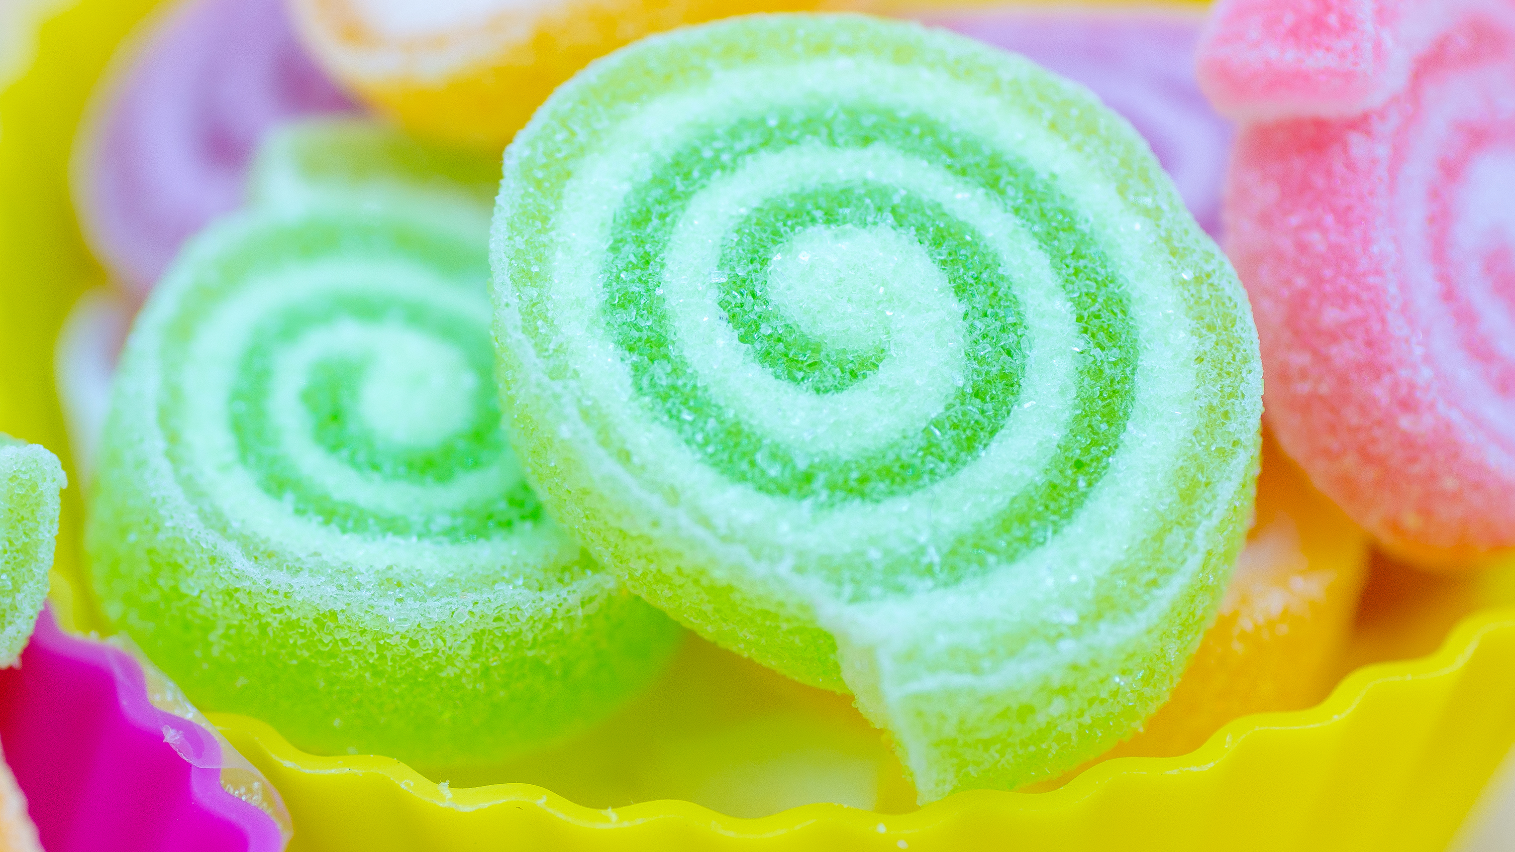
T TH
Notes:
Sweet tooth

Slide 42
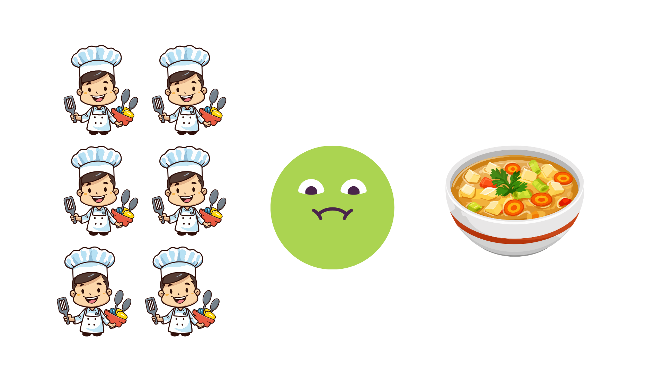
Notes:
Too many chefs/cooks spoil the broth

Slide 43
I’M YOU
Notes:
I’m bigger than you

Slide 44
LIFALLNE
Notes:
Fall in line

Slide 45


ANGLE ANGLE ANGLE
Notes:
Right angle

Slide 46
BAN ANA
Notes:
Banana split

Slide 47
now re
he
Notes:
He came out of nowhere

Slide 48


B B
Notes:
to be or not to be

Slide 49
fa
st
Notes:
breakfast

Slide 50
RUNNING
MT
Notes:
Running on empty

Slide 51
LEM
ADE
Notes:
lemonade

Slide 52
G
E
G
S
Notes:
Scrambled eggs

Slide 53
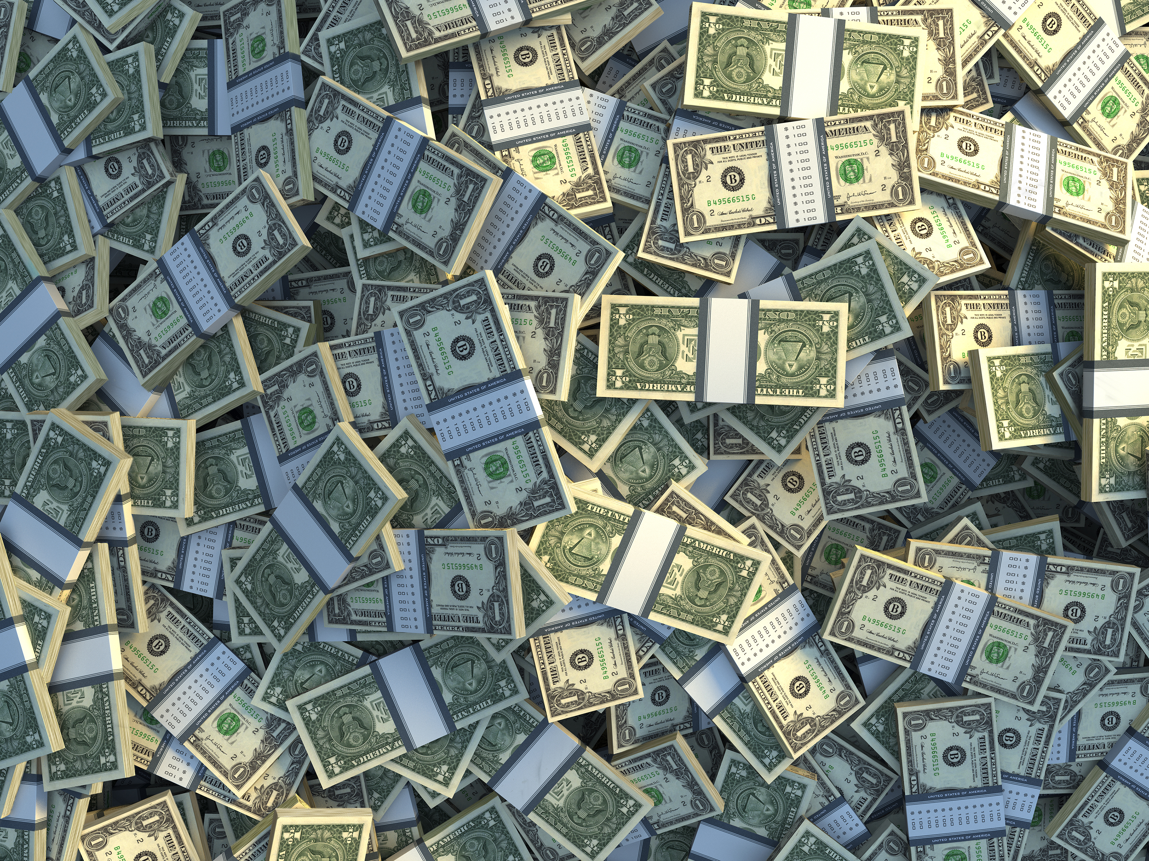

Notes:
Money talk

Slide 54


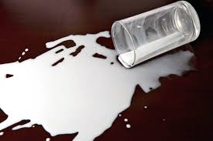
Notes:
Don’t cry over spilled milk

Slide 55



Notes:
Raining cats and dogs

Slide 56
talk
Notes:
Small talk

Slide 57

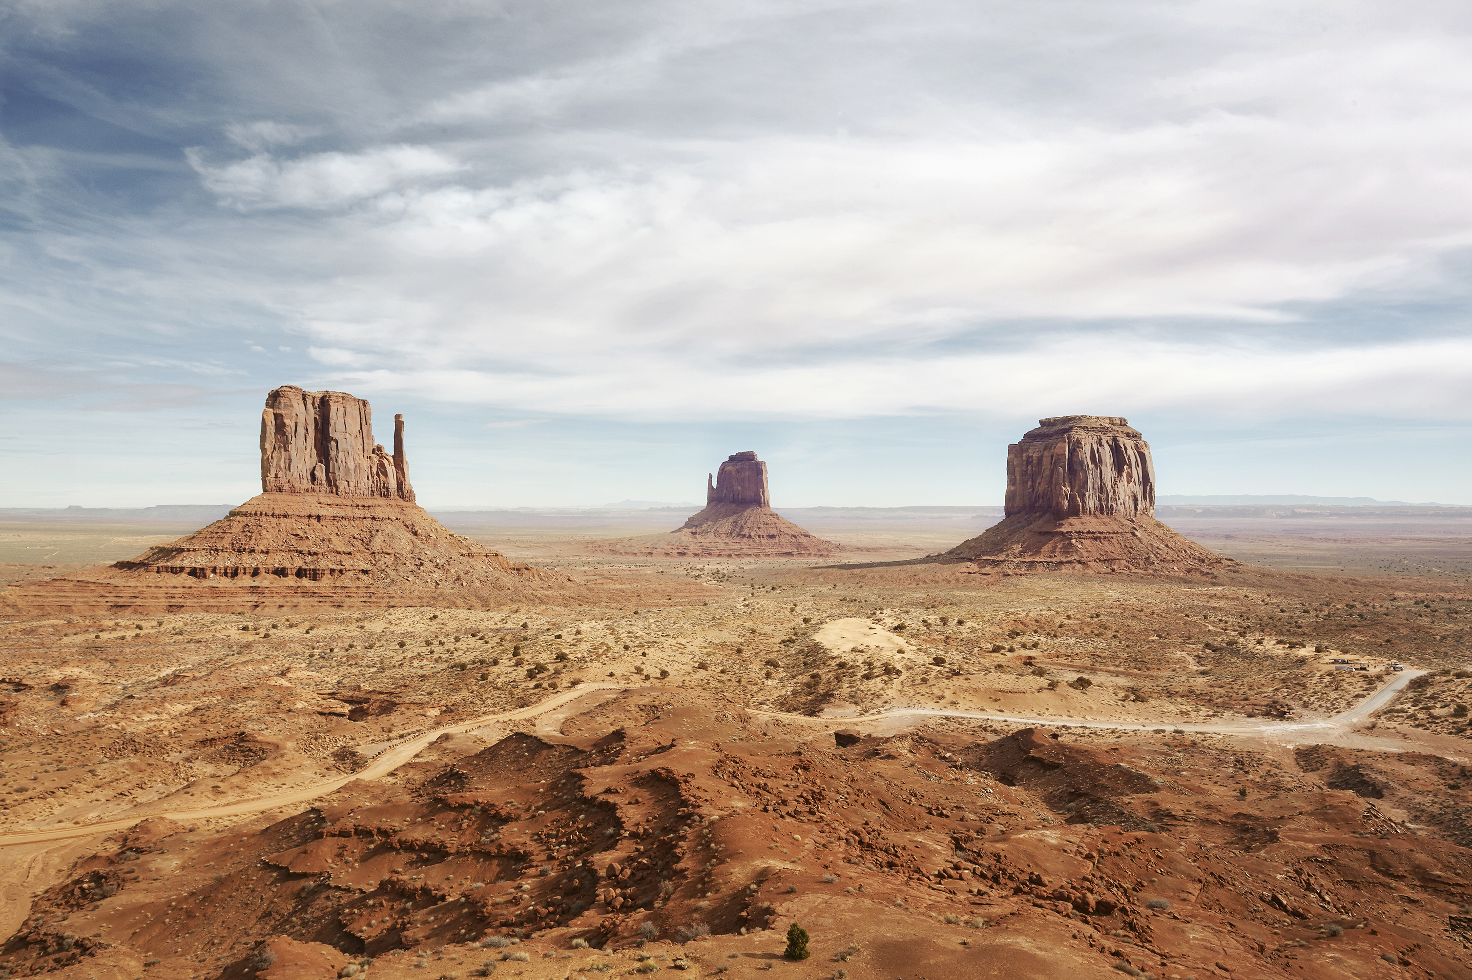

Notes:
lantern

Slide 58
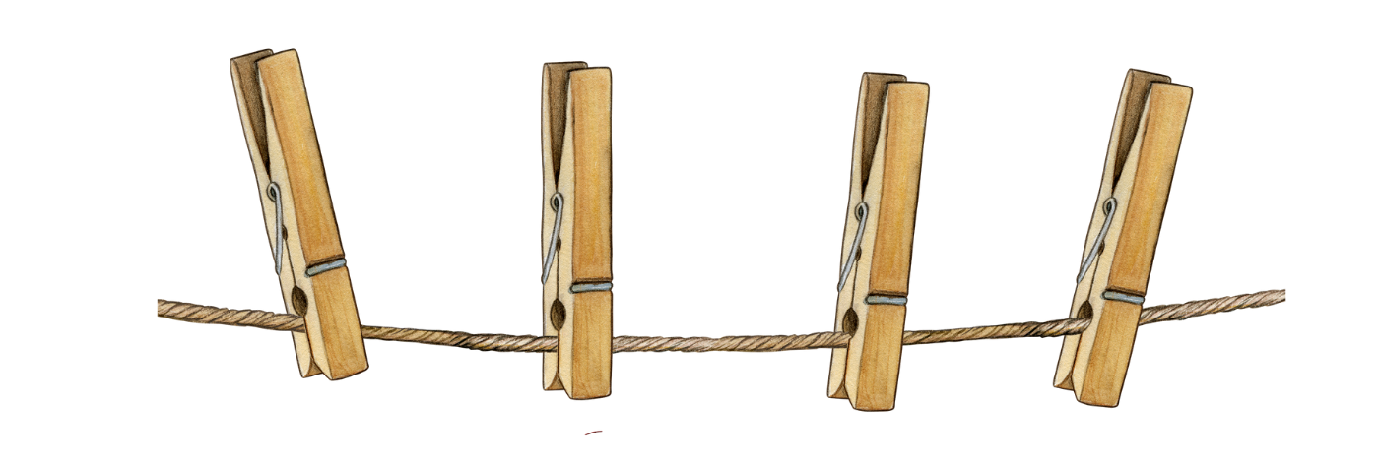
O
U
T
Notes:
hangout

Slide 59

Notes:
Lion dance

Slide 60

Notes:
fireworks

Slide 61
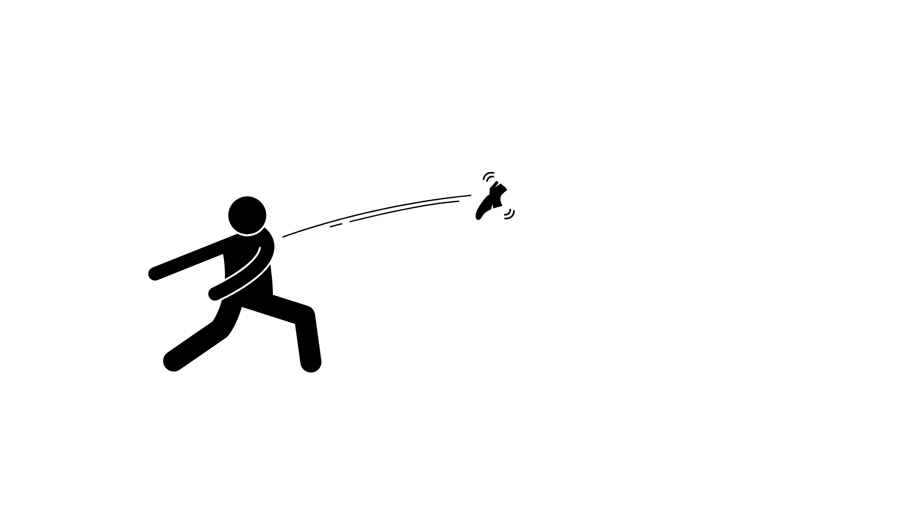
R
S
P
P
O
E
R
T
I
Y
Notes:
Prosperity toss

Slide 62
THANK YOU FOR PLAYING!

